Slide 1


On a post-quantum SIDH-based Oblivious Transfer and its implementation
Marco Carolla
Relatore: Riccardo Aragona
Correlatore: Federico Pintore

Slide 2
Index
Introduction
Post-Quantum cryptography
Isogeny-based cryptography
Oblivious Transfers
The SIDH-based OT protocol
Security
Implementation
Conclusions and future developments

Slide 3
Introduction
The one we are considering is a post-quantum cryptographic protocol designed by Vanessa Vitse in 2019.
The proposed algorithm relies on the Computational Supersingular Isogeny Problem, which is supposed to be quantum resistant, for its security.
We worked on the first Open Source implementation for this protocol.

Slide 4
Post-Quantum cryptography
Quantum computers pose a threat to classical cryptography: Shor’s quantum algorithm can solve both the Integer Factorisation and the Discrete Logarithm Problem in polynomial time.
Post-quantum cryptography:
Cryptography's branch aiming at protecting information from both classical and quantum attacks;
Its schemes are designed for classical computers;
Provides lighter confidence compared to classic alternatives

Slide 5
Isogeny-based cryptography
Isogeny-based cryptography is a very young field, born in the second half of 2010. It is based on the Computational Supersingular Isogeny Problem for which does not exists any efficient quantum attack.
Computational Supersingular Isogeny Problem: “Given two isogenous supersingular elliptic curves E, and E′, find an isogeny 𝜙 such that 𝜙 : E → E′, if it exists”.

Slide 6
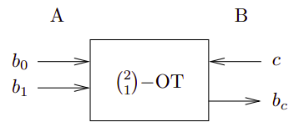
Oblivious Transfers
A known problem in cryptography is to send one out of many pieces of information to a party B while the sender, A, has no knowledge about which piece has been sent. The Oblivious Transfer (OT) scheme solves this problem.
A common variation, proposed by Even, Goldreich and Lempel, is called “1-out-of-2 Oblivious Transfer” and can be generalised to a “1-out-of-n Oblivious Transfer”.

Slide 7

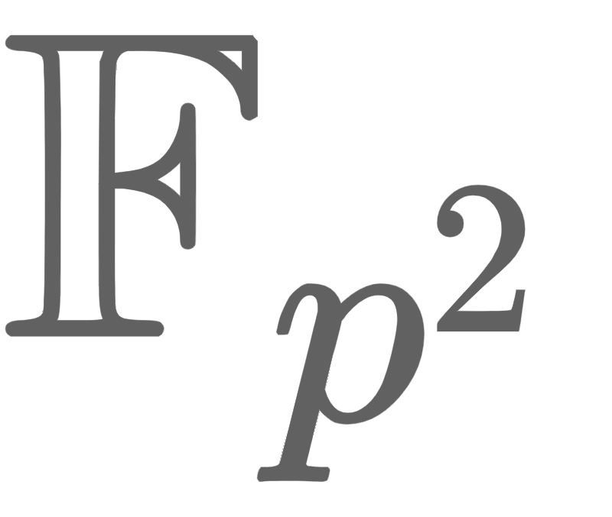

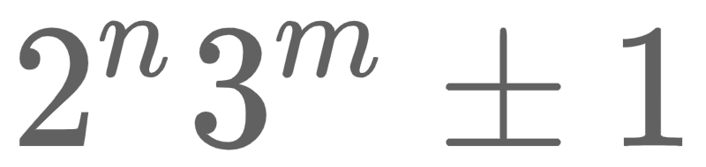
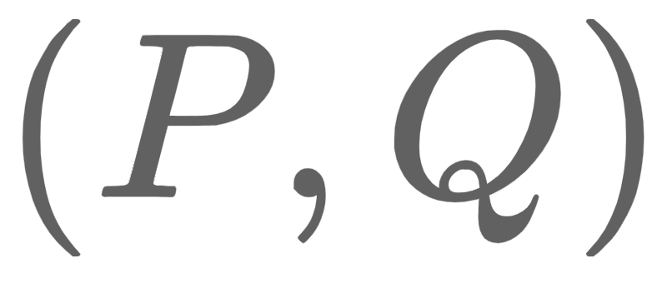
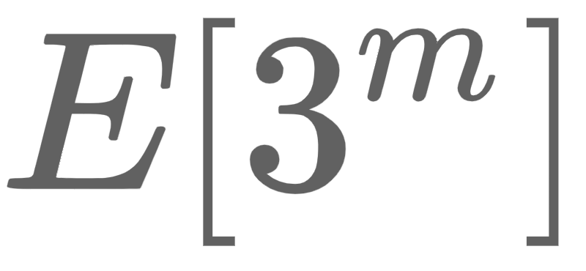


The SIDH-based OT protocol
Proposed by Vanessa Vitse, the SIDH-based OT is an oblivious transfer based on a variation of the Supersingular Isogeny Diffie-Hellman scheme.
The protocol initially requires both parties to agree upon a common supersingular elliptic curve defined over where is a prime of the form , on a basis
of , an encryption function Enc and a Key Derivation Function KDF.
For simplicity we consider a standard “1-out-of-2 Oblivious Transfer” with Alice secrets being and .

Slide 8
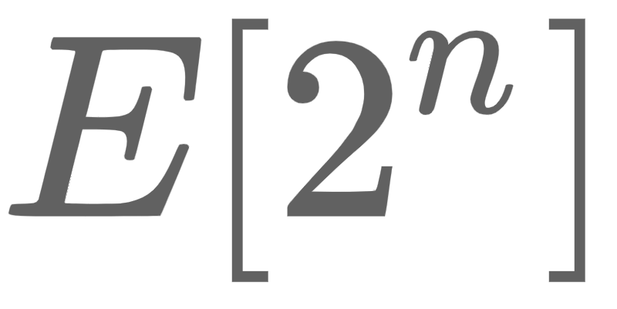
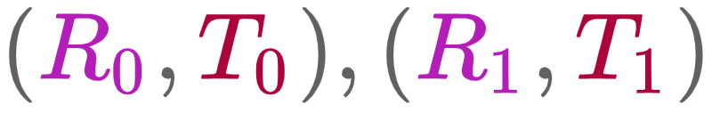


The protocol - Alice (1)
The protocol begins with Alice computing:
Two basis for namely ;
Two curves and two isogenies
Two pairs of points
Finally she sends Bob the two tuples:

Slide 9
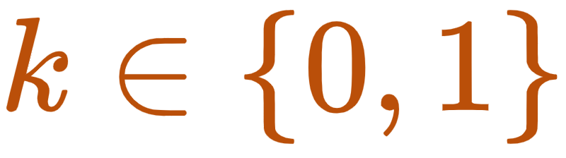
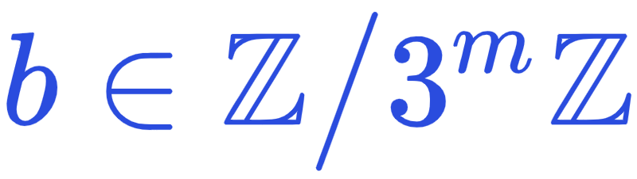
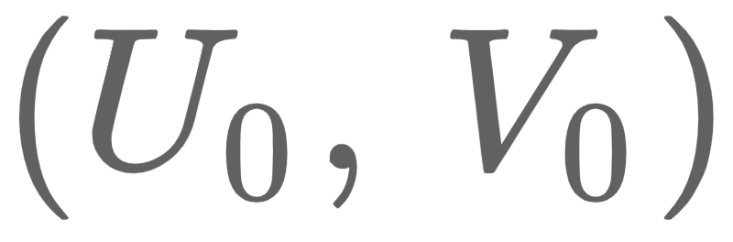
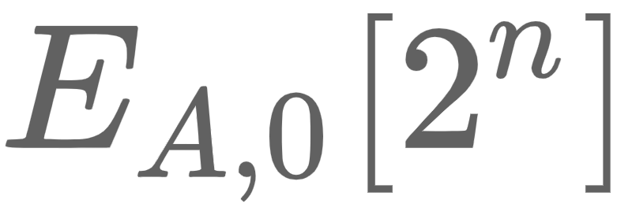
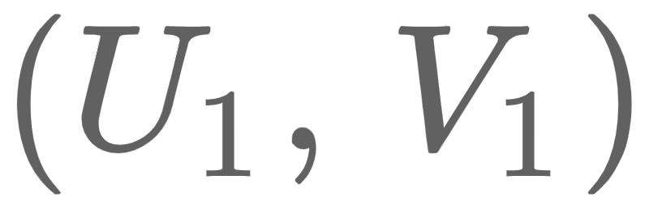
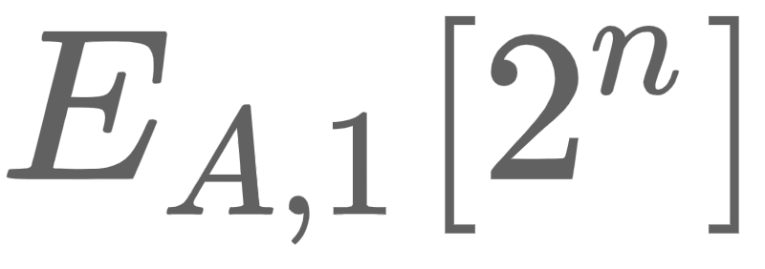

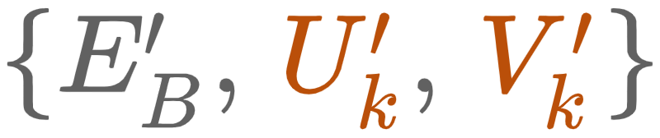
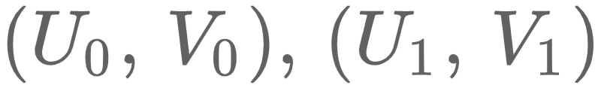
The protocol - Bob (2)
Bob chooses a bit and the integer , and computes:
The curve and its j-invariant
The curve and the isogeny
The bases for and for
All bases must have the same Weil pairing
The points
He sends Alice and the bases

Slide 10
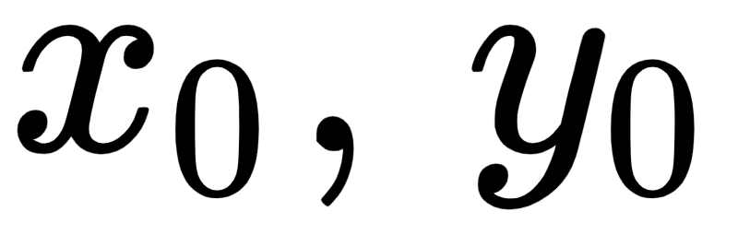
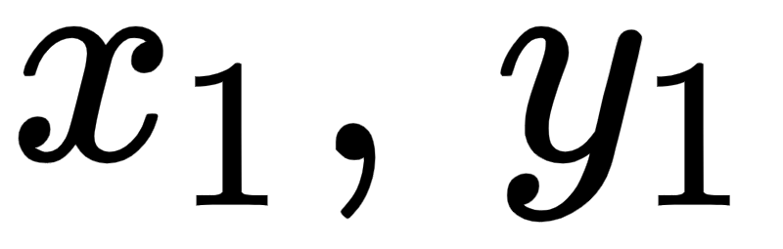




The protocol - Alice (3)
Alice now has to find the integers and such that:
She can now compute two curves and their corresponding j-invariants:
She encrypts her two secrets and send them to Bob as:

Slide 11

The protocol - Bob (4)
In this last step, Bob decrypts his chosen k-th secret as:

Slide 12
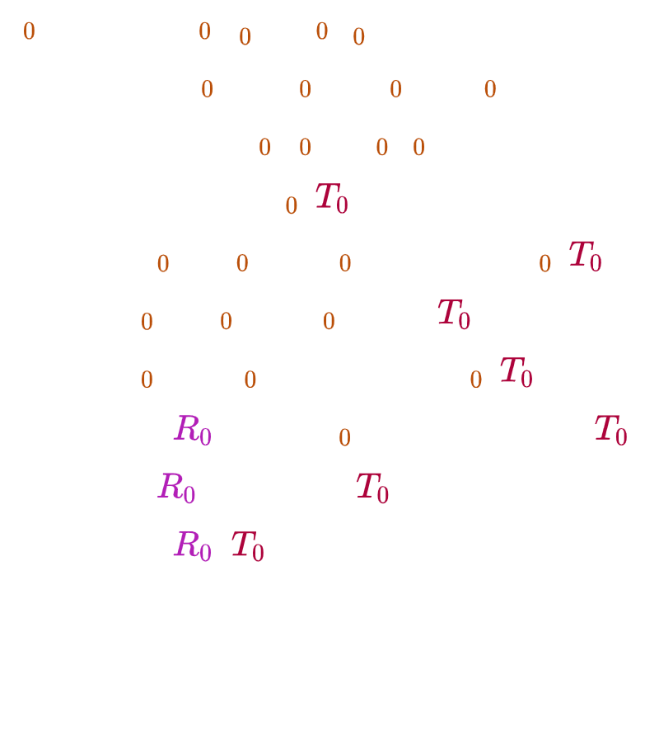


Correctness
Bob is able to decrypt Alice k-th secret since his curve is isomorphic to Alice’s . Consequently, the two curves share the same j-invariant!
We will consider k = 0 for simplicity and without loss of generality.

Slide 13

Security
The SIDH-based OT security guarantees that a malicious Alice should not be able to know Bob’s chosen secret k. On the other side, a malicious Bob should not be able to recover Alice’s secrets other than her .
These security (semantical/computational) requirements are reached assuming the quantum-hardness of some isogeny-based mathematical problems.

Slide 14
The implementation
The implementation is based on SIKE’s library, submitted to NIST’s Post-Quantum-Cryptography Standardization Challenge.
The entire protocol required less than 100 lines of code. Many functions have been adapted from SIKE’s library and many others implemented anew.
Our implementation works with all quantum security levels, and supports all curves provided in the library.

Slide 15

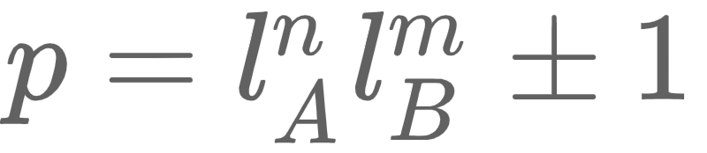
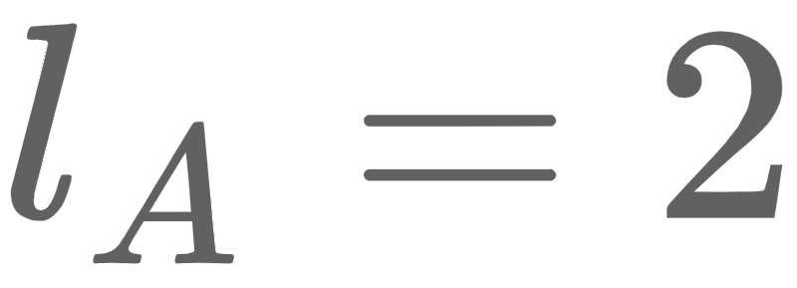
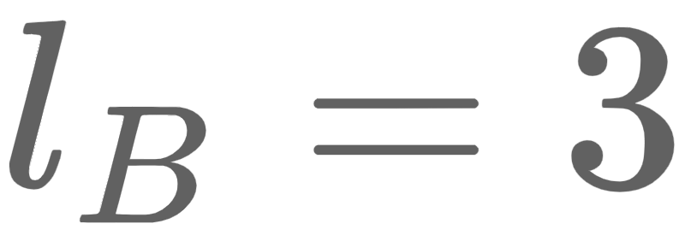
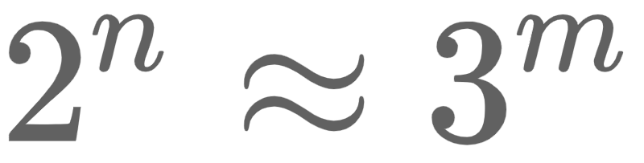

Implementation choices
SIKE’s library
Supersingular Isogeny Key Exchange, a variation of SIDH
C language implementation
x64 target platforms
Timing and cache attacks protection
Optimised implementation with compressed parameters
Prime fields with where
Bases are fixed to and ;
Exponents are chosen such that and chosen in [100, 500] accordingly to the security level required.

Slide 16

Optimisation choices
Montgomery curves with affine form
Reduced number of operations for the group law
Only x-coordinates computations
Differential Addition to further improve the group law
Projective coordinates
Montgomery projective form:
Minimised “inversion” operations
Faster arithmetics by ignoring the Y projective coordinate
Faster and more efficient isogeny arithmetic by ignoring the curve coefficient B
Projective isogenies of 3- and 4-degree
Isogeny trees
Traversing strategies

Slide 17
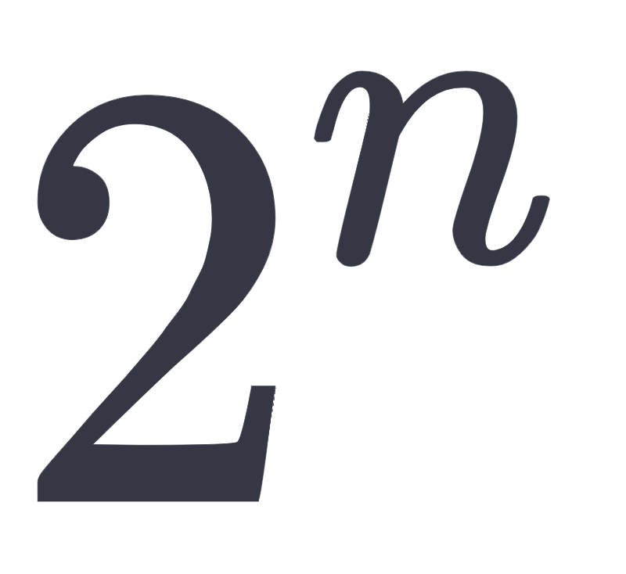

Basic functions implemented
Generation of -order basis in projective short form
Weil pairing computation of order , reduced from previous order
Elliptic curve arithmetic:
Point addition in both affine and projective coordinates
Point difference
Projective Y computation
Conversions:
Affine point P = (x, y) to its projective short form P = (X : Z) with X = x, Z = 1
Affine point P = (x, y) to its projective full form P = (X : Y : Z) with X = x, Y = y, Z = 1
Projective short form to projective full form

Slide 18
More complex algorithms
We adapted the SIKE’s algorithm for the 2-isogeny computation and coded three ad-hoc functions to better meet our requirements. Similarly for the 3-isogeny computation.
In Alice’s second step, specific linear combination are required. Our momentary solution relies on a random guessing function (given our current knowledge the problem has exponential complexity).
Enc and KDF functions are based on shake256 library from a NIST publication regarding SHA3. The Enc function does not perform one-time-pad encryption but trims the encryption key to the message’s length.

Slide 19
Conclusions and future developments
We have studied and implemented a recent post-quantum protocol providing its first implementation, under GNU Licence. We chose to implement it exploiting an optimised library with compressed parameters.
In future developments we hope to see an efficient computation for Alice’s linear combinations, standardised point coordinates, less variable conversions between methods and other minor improvements.
Finally it would be interesting to implement different post-quantum OT protocols and benchmark them.

Slide 20
Thank you for your attention
Questions?

